Slide 1
Memory Organization:
Cache and Virtual Memory
(Lecture 59-60)

Slide 2
Fundamental concepts
Following are the fundamental concepts in understanding the performance characteristics of memory hierarchies and cache systems in computer architecture.
Hit: Occurs when the data requested by the processor is found in the cache (or memory level being accessed). This means the processor doesn't need to access a slower memory level to retrieve the data.
Miss: Occurs when the data requested by the processor is not found in the cache (or memory level being accessed), necessitating a retrieval from a slower memory level, such as main memory (RAM) or even disk storage.
Hit Rate: The percentage of all memory accesses that result in hits. It's calculated as the number of hits divided by the total number of memory accesses. The ratio of the number of hits divided by hits plus misses is the hit ratio.
Miss Rate: The percentage of all memory accesses that result in misses. As you correctly stated, it's equal to 1−Hit Rate.
Hit Time: The time required to access data when a hit occurs. This is typically much faster than accessing data from a slower memory level like RAM or disk.
Miss Penalty: The time required to process a miss. It includes the time it takes to replace a block of memory (if necessary) and the time it takes to retrieve the requested data from a slower memory level (like RAM or disk). It's the performance cost incurred when a cache miss happens.

Slide 3
Principles of Locality
An entire blocks of data is copied after a hit because the principle of locality tells us that once a byte is accessed, it is likely that a nearby data element will be needed soon. There are three forms of locality. These forms of locality are fundamental principles in computer architecture and are key factors in designing efficient cache systems and memory hierarchies
Temporal Locality: This refers to the idea that if a particular memory location is accessed, it's likely that the same location will be accessed again in the near future. This principle is based on the observation that programs often exhibit repeated access to the same data or instructions within a short time frame. Caches exploit temporal locality by keeping recently accessed data in the cache, increasing the likelihood of a hit.
Spatial Locality: Spatial locality suggests that if a memory location is accessed, neighbouring memory locations will also be accessed in the near future. This principle is based on the observation that programs tend to access memory locations that are close to each other. Caches exploit spatial locality by fetching entire blocks of contiguous memory (cache lines) into the cache upon a cache miss.
Sequential Locality: Sequential locality refers to the tendency of programs to access memory locations sequentially. This is particularly relevant for instruction fetching, where the CPU typically fetches instructions in sequential order. Caches can prefetch sequential blocks of instructions or data into the cache to exploit this locality, reducing the impact of cache misses.

Slide 4
Purpose of Cache
The purpose of cache memory is to speed up accesses by storing recently used data closer to the CPU, instead of storing it in main memory.
Although cache is much smaller than main memory, its access time is a fraction of that of main memory.
Unlike main memory, which is accessed by address, cache is typically accessed by content; hence, it is often called content addressable memory.
Because of this, a single large cache memory isn’t always desirable-- it takes longer to search.
Cache exploits the principle of locality, which includes temporal, spatial, and sequential locality.
This helps in speeding up program execution since the CPU spends less time waiting for data to be fetched from slower main memory.
Accessing data from cache consumes less power compared to accessing data from main memory. This is because cache memory is typically implemented using low-power, high-speed technologies such as static RAM (SRAM).

Slide 5
Basic Cache Operation
The basic operation of the cache is as follows.
When the CPU needs to access memory, the cache is examined. If the word is found in the cache, it is read from the fast memory.
If the word addressed by the CPU is not found in the cache, the main memory is accessed to read the word.
A block of words containing the one just accessed is then transferred from main memory to cache memory. The block size may vary from one word (the one just accessed) to about 16 words adjacent to the one just accessed.
In this manner, some data are transferred to cache so that future references to memory find the required words in the fast cache memory.

Slide 6
Mapping Process
The basic characteristic of cache memory is its fast access time. Therefore, very little or no time must be wasted when searching for words in the cache. The transformation of data from main memory to cache memory is referred to as a mapping process.
Three types of mapping procedures are of practical interest when considering the organization of cache memory:
1. Direct mapping, each block of main memory can only be mapped to one specific cache line.
2. Associative mapping, each block of main memory can be placed in any cache line.
3. Set-associative mapping, combines the advantages of both direct and associative mapping.

Slide 7
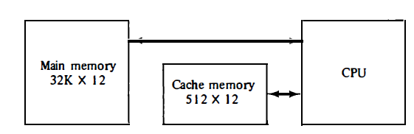
Mapping Process (Cont..)
Let us discuss these three mapping procedures by using a specific example of a memory organization as shown in below.
The main memory can store 32K words of 12 bits each.
The cache is capable of storing 512 of these words at any given time.
For every word stored in cache, there is a duplicate copy in main memory.
The CPU communicates with both memo­ries. It first sends a 15-bit address to cache.
If there is a hit, the CPU accepts the 12-bit data from cache.
If there is a miss, the CPU reads the word from main memory and the word is then transferred to cache.
Example of cache memory

Slide 8
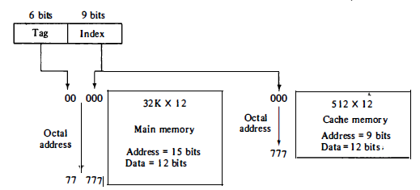
Direct Mapping
Associative memories are expensive compared to random-access memories because of the added logic associated with each cell.
The easiest technique used for mapping is known as direct mapping. In simpler words, in the case of direct mapping, we assign every memory block to a certain line in the cache. This is achieved by using part of the memory address to determine the cache location.
The possibility of using a random-access memory for the cache is investigated in below figure.
The CPU or main memory address of 15 bits is divided into two fields. The nine least significant bits constitute the index field and the remaining six bits form the tag field.
Fig: Addressing relationships between main and cache memories

Slide 9
Direct Mapping (Cont..)
The figure shows that main memory needs an address that includes both the tag and the index bits.
The number of bits in the index field is equal to the number of address bits required to access the cache memory.
Here, In a direct mapped cache consisting of N blocks of cache, block X of main memory maps to cache block Y = X mod N.
Thus, if we have 10 blocks of cache, block 7 of cache may hold blocks 7, 17, 27, 37, . . . of main memory.

Slide 10
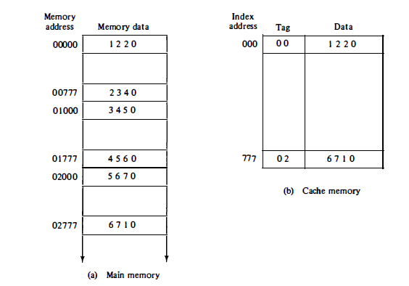
Direct Mapping (Cont..)
In the general case, there are 2^k words in cache memory and 2^n words in main memory. The n-bit memory address is divided into two fields: k bits for the index field and n - k bits for the tag field.
The direct mapping cache organization uses the n-bit address to access the main memory and the k-bit index to access the cache.
The internal organization of the words in the cache memory is as shown below.
Fig: Direct mapping cache organization

Slide 11
Direct Mapping (Cont..)
Each word in cache consists of the data word and its associated tag.
When a new word is first brought into the cache, the tag bits are stored alongside the data bits.
When the CPU generates a memory request, the index field is used for the address to access the cache. The tag field of the CPU address is compared with the tag in the word read from the cache.
If the two tags match, there is a hit and the desired data word is in cache. If there is no match, there is a miss and the required word is read from main memory. It is then stored in the cache together with the new tag, replacing the previous value.
The disadvantage of direct mapping is that the hit ratio can drop considerably if two or more words whose addresses have the same index but different tags are accessed repeatedly.
However, this possibility is minimized by the fact that such words are relatively far apart in the address range (multiples of 512 locations in this example).

Slide 12
Numerical Example -Direct Mapping
To see how the direct-mapping organization operates, consider the numerical example using a block size of one word.
The word at address zero is presently stored in the cache (index = 000, tag = 00, data = 1220) as shown in previous silde.
Suppose that the CPU now wants to access the word at address 02000. The index address (last 3 digits of 5 digits main memory address) is again 000, so it is used to access the cache.
The two tags are then compared. The cache tag is 00 as shown in cache memory with index address, 000 but the address tag is 02 as shown in main memory, which does not produce a match.
Therefore, the main memory is accessed and the data word 5670 is transferred to the CPU.
The cache word at index address 000 is then replaced with a tag of 02 and data of 5670.

Slide 13
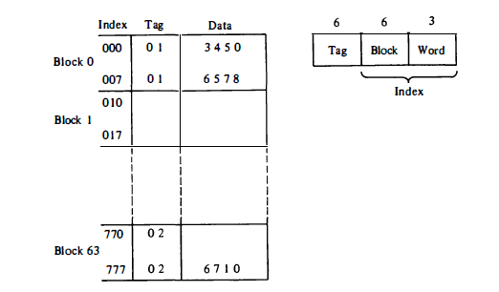
Direct Mapping (with block size of multi words)
Direct Mapping using a block size of multi (8) words as shown below.
Note: The index field is now divided into two parts (earlier this was not divided): the block field and the word field.
In a 512-word (64 x 8) cache there are 64 blocks of 8 words each.
The block number is specified with a 6-bit field and the word within the block is specified with a 3-bit field.
The tag field stored within the cache is common to all 8 words of the same block.
Every time a miss occurs, an entire block of eight words must be transferred from main memory to cache memory. Although this takes extra time, the hit ratio will most likely improve with a larger block size because of the sequential nature of computer programs.
Fig: Direct mapping cache with block size of 8 words.

Slide 14
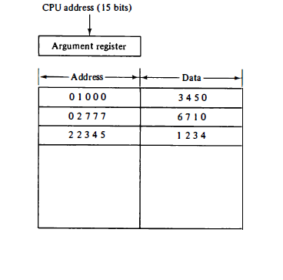
Associative Mapping
In this mapping each block of main memory can be placed in any cache line so that is available freely at that particular moment.
It helps to make this fastest and most flexible cache organization than direct mapping.
Associative mapping organization is shown below in which associative memory stores both the address and content (data) of the memory word.
This permits any location in cache to store any word from main memory
Fig: Associative mapping cache (all numbers in octal).

Slide 15
Associative Mapping (Cont..)
The address value of 15 bits is shown as a five-digit octal number and its corresponding 12 -bit word is shown as a four-digit octal number.
A CPU address of 15 bits is placed in the argument register and the associative memory is searched for a matching address.
If the address is found, the corresponding 12-bit data is read and sent to the CPU. If no match occurs, the main memory is accessed for the word.
The address - data pair is then transferred to the associative cache memory. If the cache is full, an address--data pair must be displaced to make room for a pair that is needed and not presently in the cache.
The decision as to what pair is replaced is determined from the replacement algorithm that the designer chooses for the cache.
A simple procedure is to replace cells of the cache in round-robin order whenever a new word is requested from main memory. This constitutes a first-in first-out (FIFO) replacement policy.

Slide 16
Set-Associative Mapping
It was mentioned previously that the disadvantage of direct mapping is that two words with the same index in their address but with different tag values cannot reside in cache memory at the same time.
A third type of cache organization, called set-associative mapping, is an improvement over the direct mapping organization in that each word of cache can store two or more words of memory under the same index address.
Each data word is stored together with its tag and the number of tag-data items in one word of cache is said to form a set.
An example of a set-associative cache organization for a set size of two is shown in next slide.
Each index address refers to two data words and their associated tags.
Each tag requires six bits and each data word has 12 bits, so the word length is 2(6 + 12) = 36 bits.
An index address of nine bits can accommodate 512 words. Thus the size of cache memory is 512 x 36.
It can accommodate 1024 words of main memory since each word of cache contains two data words. In general, a set-associative cache of set size k will accommodate k words of main memory in each word of cache.

Slide 17
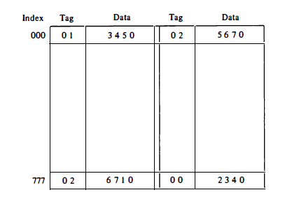
Set-Associative Mapping (Cont..)
The octal numbers listed in below figure are with reference to the main memory contents illustrated in Figure of Direct mapping cache organization.
The words stored at addresses 01000 and 02000 of main memory are stored in cache memory at index address 000.
Similarly, the words at addresses 02777 and 00777 are stored in cache at index address 777.
Fig: Two-way set-associative mapping cache

Slide 18
Set-Associative Mapping (Cont..)
When the CPU generates a memory request, the index value of the address is used to access the cache. The tag field of the CPU address is then compared with both tags in the cache to determine if a match occurs.
The comparison logic is done by an associative search of the tags in the set similar to an associative memory search: thus the name "set-associative."
The hit ratio will improve as the set size increases because more words with the same index but different tags can reside in cache. However, an increase in the set size increases the number of bits in words of cache and requires more complex comparison logic.
When a miss occurs in a set-associative cache and the set is full, it is necessary to replace one of the tag-data items with a new value. The most common replacement algorithms used are: random replacement, first-in first-out (FIFO), and least recently used (LRU).
With the random replacement policy the control chooses one tag-data item for replacement at random. The FIFO procedure selects for replacement the item that has been in the set the longest.
The LRU algorithm selects for replacement the item that has been least recently used by the CPU.
Both FIFO and LRU can be implemented by adding a extra bits in each word of cache.

Slide 19
Writing into Cache
During a read operation, when the CPU determines a word in the cache, the main memory is not included in the transfer. However, if the operation is a write, there are two ways that the system can proceed.
1. Write Through Method : The simplest and most commonly used procedure is to update main memory with every memory write operation, with cache memory being updated in parallel if it contains the word at the specified address. This is called the write-through method. This method has the advantage that main memory always contains the same data as the cache.
2. Write Back Method : During this operation, only the cache location is updated during write operation. Then, the location is marked by a flag so that it is later copied to the main memory when the word is removed from the cache. The reason for the write-back method is that during the time a word resides in the cache, it may be updated several times; however, as long as the word remains in the cache, it does not matter whether the copy in main memory is out of date, since requests from the word are filled from the cache. It is only when the word is displaced from the cache that an accurate copy need be rewritten into main memory.

Slide 20
Cache Initialization
One of the aspect of cache organization that must be taken into consideration is the problem of initialization.
The cache is initialized when power is applied to the computer or when the main memory is loaded with a complete set of programs from auxiliary memory.
After initialization the cache is considered to be empty, but in effect it contains some nonvalid data. It is customary to include with each word in cache a valid bit to indicate whether or not the word contains valid data.
The cache is initialized by clearing all the valid bits to 0. The valid bit of a particular cache word is set to 1 the first time this word is loaded from main memory and stays set unless the cache has to be initialized again.
The introduction of the valid bit means that a word in cache is not replaced by another word unless the valid bit is set to 1 and a mismatch of tags occurs.
If the valid bit happens to be 0, the new word automatically replaces the invalid data.
Thus the initialization condition has the effect of forcing misses from the cache until it fills with valid data.

